Slide 1


Slide 2
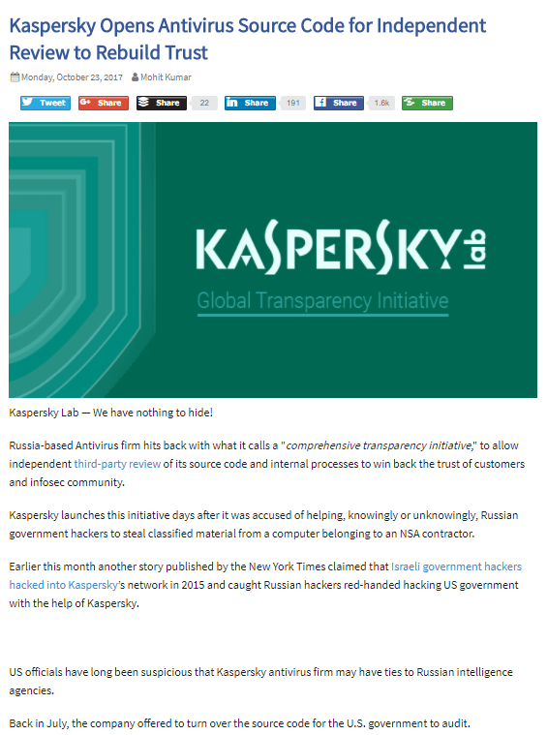
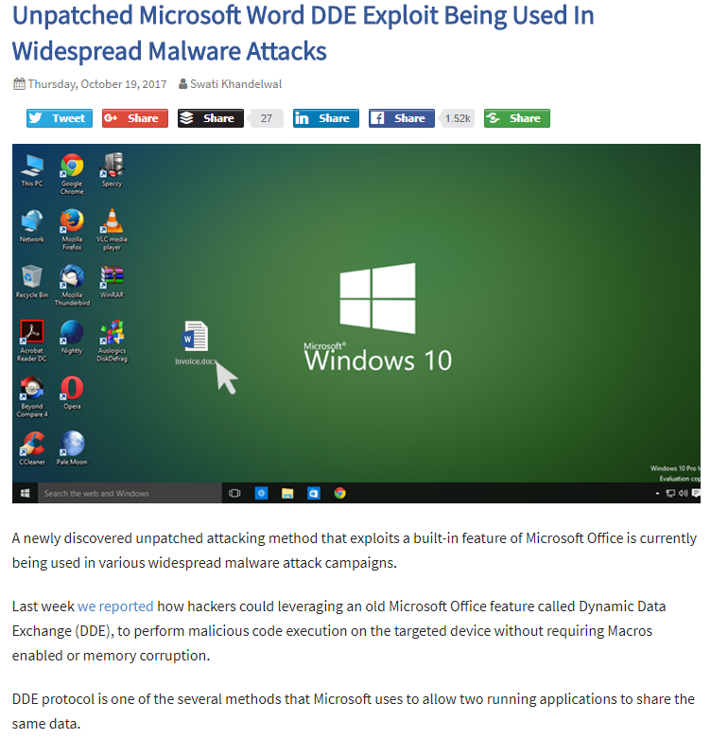
News 2017

Slide 3


Python

Slide 4
What Can I do with Python?
Systems Programming.
GUIs (Graphical User Interface); Python/Tkinter toolkit.
Internet Scripting; client and server modes.
Component Integration.
Database Programming.
Numeric Programming. NumPy.
Gaming, Images, AI, XML, and More…

Slide 5

What Are Python’s Technical Strengths?
It’s object –oriented languaje.
It’s portable.
It’s powerful.

Slide 6
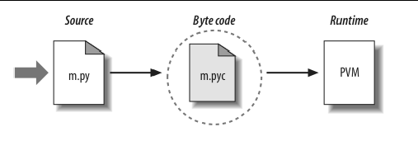
Python Interpreter

Slide 7
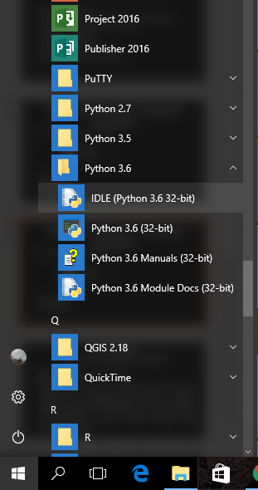
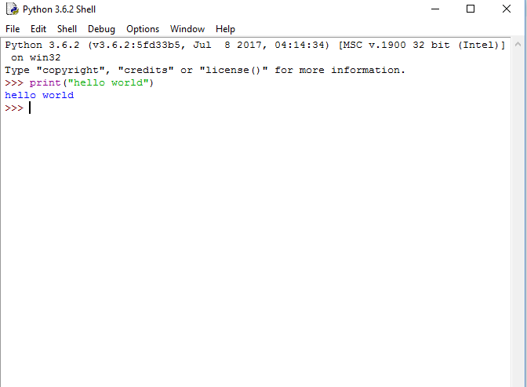
Python Interpreter

Slide 8
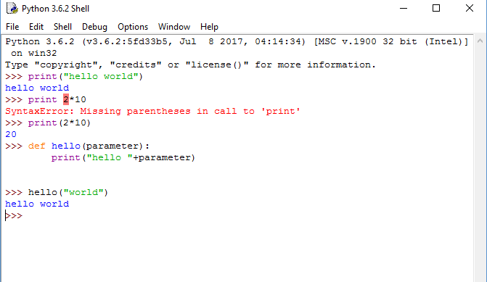
Python Interpreter

Slide 9
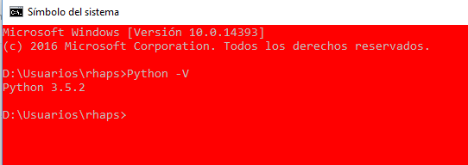
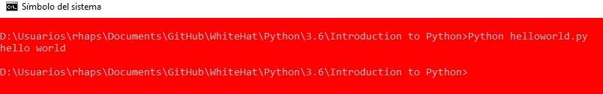

Python Interpreter

Slide 10


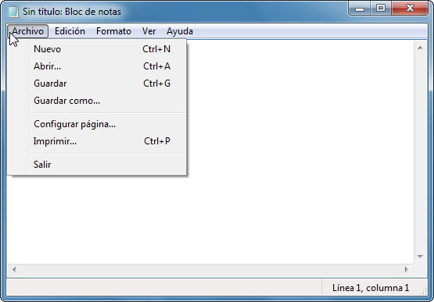
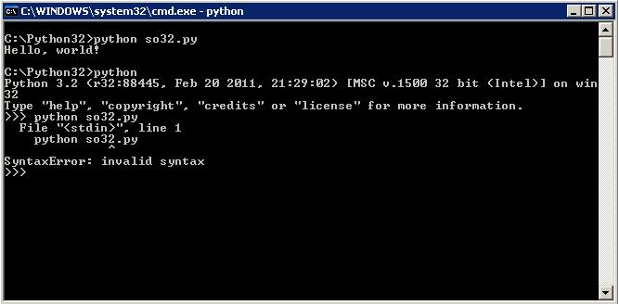
Integrated Development Enviroment (IDE)

Slide 11




Other Resources …

Slide 12
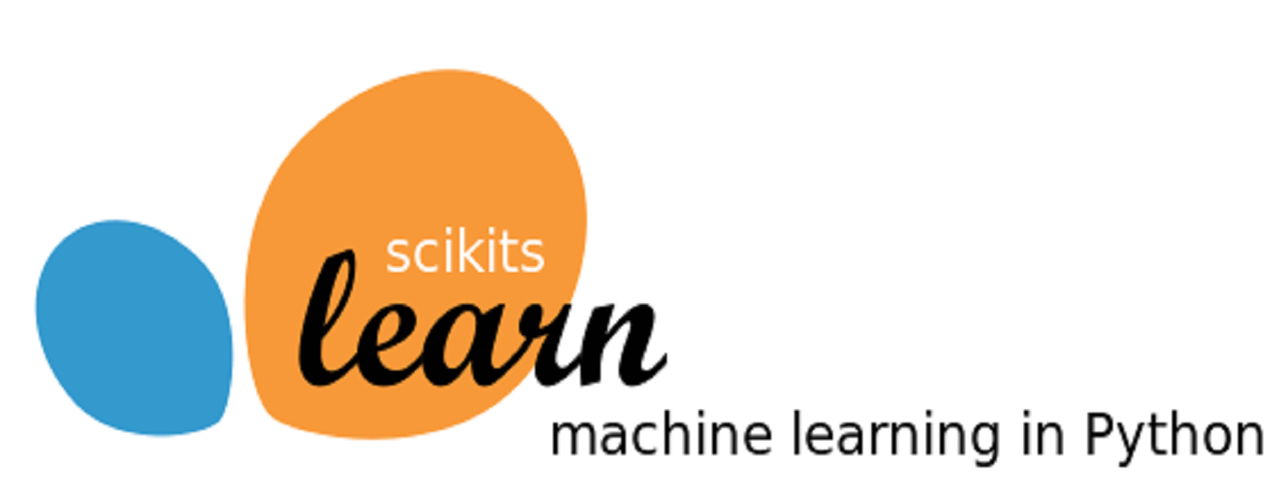
http://scikit-learn.org/stable/

Slide 13
Churn example
We can find some open source datasets avaiable, such as:
https://www.kdnuggets.com/datasets/index.html
http://www.iainpardoe.com/teaching/dsc433/data.htm

Slide 14


Slide 15
Bibliografía
Lutz, Mark. Learning Python: Powerful Object-Oriented Programming. " O'Reilly Media, Inc.", 2013.
Seitz, J. (2014). Black Hat Python: Python Programming for Hackers and Pentesters. No Starch Press.

Slide 16


